Slide 1





ENHANCING DATA DASHBOARD FOR STREAMLINED INTERACTION AND CLEAR DATA INSIGHTS
Akanksha Shridharani
Pranav Shankaran

Slide 2




MEET THE TEAM
TINA FLEMING
Member Relations Manager
BEN YEOH
Events & Partnership Coordinator
DANIELLE HARGROVE
Marketing & Communications Lead
SONA SWINDLEY
Events & Partnership Lead

Slide 3

Overview
Who is EducatePlus?
Problem Statement
Current & New Reporting Frameworks
Key Variables
Our Approach
Dashboards Demo
Scope For Improvement

Slide 4
Who is EducatePlus?
Membership organization supporting professionals in educational advancement through seminars and conferences.
Serves schools, colleges, universities, professional training institutes, and related consultancies.

Slide 5



PROBLEM STATEMENT
Problem 1
Problem 2
Problem 3
How do we leverage our current data to drive decision-making?
Time-consuming reporting
How do we send personalized communication to different members?

Slide 6

CURRENT REPORTING FRAMEWORK
CiviCRM
Member information, Events and attendance data, Invoices
Member Dashboard
Google Sheet
(Staging Database)
Members & Memberships Data
Contact type, membership by chapter, New Members, Institution type, Member type break-up, Members by country

Slide 7
NEW REPORTING FRAMEWORK
Member Dashboard
Google Sheet 1
- Members
- Memberships
CiviCRM
Member & Membership information, Events and attendance data, Invoices
Membership Dashboard
Google Sheet 2
- Events Attendance
Events Dashboard

Slide 8
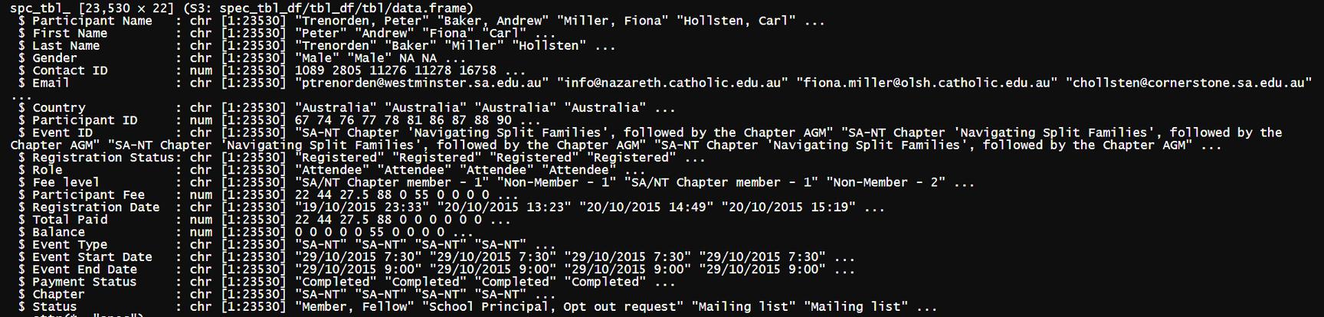
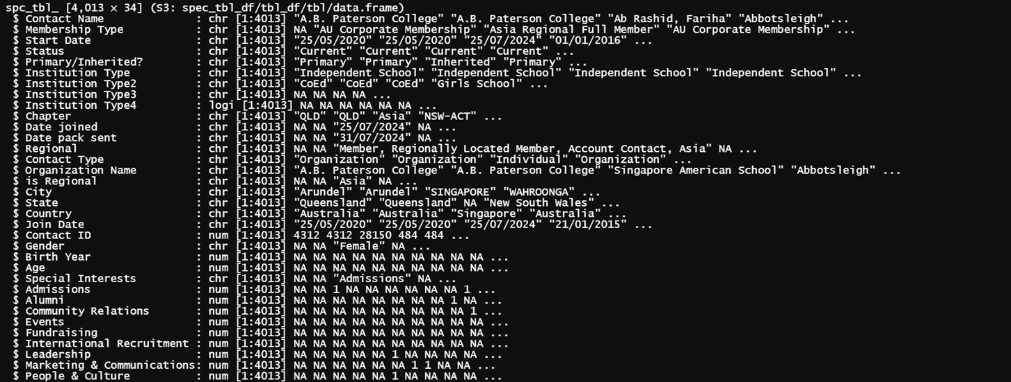
DATA DICTIONARY

Slide 9


KEY VARIABLES
Members Data
Events Attendance Data
Name
<Text/>
Chapter
<Text/>
Unique ID
<Numeric/>
Location
<String/>
Event ID
<String/>
Fee Paid
<Numeric/>
Name
<String/>
e-mail ID
<String/>
Membership Type
<String/>
Membership Status
<String/>
Registration Status
<String/>
Payment Status
<String/>
DOB
<Date/>
Gender
<String/>
Interests
<String/>
Join Date
<Date/>
Start Date
<Date/>
Gender
<String/>
Member Type
<String/>
Institution Type
<String/>
Membership Start & End Dates
<Date/>
Balance Amount Due
<Numeric/>
Event Start & End Date
<Numeric/>

Slide 10
OUR APPROACH
Requirement Gathering
Dashboard Wireframe
Feedback
Dashboard Building
Stakeholder Identification
Testing

Slide 11

DASHBOARD
DEMONSTRATION

Slide 12
EVENT ENGAGEMENT LEVEL
No. of events attended
Engagement Level =
Total Available Events
x 100

Slide 13
SCOPE FOR IMPROVEMENT
More powerful dashboard tools to be used to handle complex metrics & perform predictive analytics
To “Marry” members data & Events attendance datasets
Engagement Level; Partial Picture Painted

Slide 14
THANK YOU

Slide 15
FORMULAE
Total Members – New members
Retention Rate =
Total Members
x 100
Total Members – Cumulative count of Members from previous years
Growth(%)=
x 100
Cumulative count of Members from previous years

